Slide 1
UNDERSTANDING TESLA POWERWALL ECONOMICS
…The search for a positive return
Eric Scott, 3/25/16

Slide 2

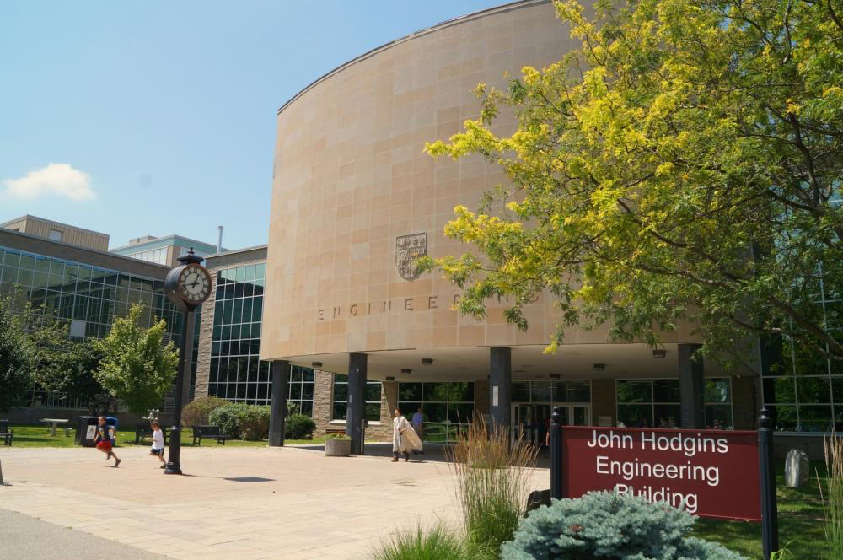

Quick Background: 1991-2011
From Toronto, Canada
McMaster University, Mechanical Eng and Management
Manufacturing engineering intern @ Linamar
Notes:
-Mcmaster is a public research university in Hamilton ontario
-one of canada’s top schools
-mech eng and management – dual degree mechanical engineering and business (5 year program)
Linamar is one of Canada’s largest manufacturing companies, primary focus on automotive
-worked as a manufacturing engineering intern assisting project engineers
-manufactured camshafts, connecting rods, and cyclinder blocks for GM, Ford and Chrysler

Slide 3
2011-2014
Shifting focus to research / environment
Numerical modeling @ Environment Canada
Research assistant @ National Institute of Nanotechnology
Notes:
Environment canada is the research division focusing on metrology and ato
The National Institute for Nanotechnology is a research institution located on the University of Alberta main campus, in Edmonton
-worked for a mechanical engineering professor in the summer – working to commercialize research from one of his PhD students
-created a 3D strain sensor, typical strain sensors only give you planar information (2D) - this used semiconductor technology to provide a 3D profile
-interest from oil&gas companies in Alberta that wanted to use it to detect leakages from pipelines
-wanted to create a network of 3D strain sensors

Slide 4


2014-current
Shifting focus to data & energy
UC Berkeley, M.Eng
Design Engineer @ SolarCity (9 months)
Notes:
Masters at UC Berkeley graduated last May
-1 year accelerated masters, engineering and business focus
-classes offered through the Haas school as well as engineering
-capstone with Gov. Granholm – American Jobs Project
-renewable energy policy around the US

Slide 5
Today’s Presentation Outline
Origins of the project
Initial look at San Francisco Region
Messing around with the parameters
Building a little application
Demo

Slide 6
Sales training video
SolarCity offering Powerwalls to homeowners
10kWh (weekly cycling) model
Sales training: cost reduction is not the value proposition
Main sell point: back-up generation
Back-up generation = no-payback
Daily cycling = possible payback???
Notes:
No longer offering the 10kWh battery – this was just over a month ago when I stared looking into the economics
-often here that a battery just doesn’t make financial sense - -I wanted to see to what degree??
-what factors were involved, how to go about solving a problem like this?

Slide 7
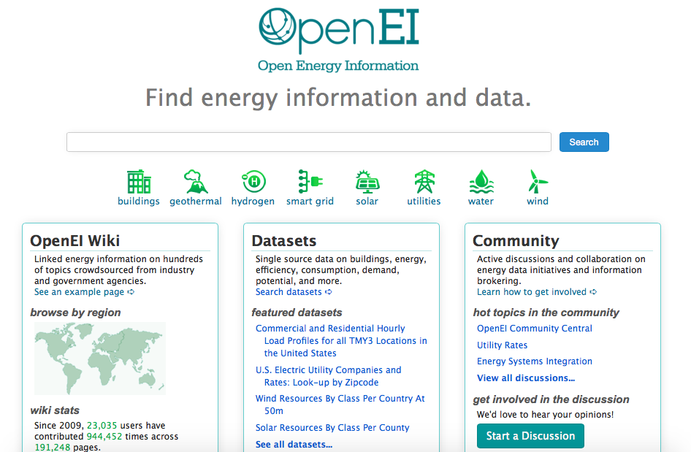
Looking for data
http://en.openei.org/datasets/dataset/commercial-and-residential-hourly-load-profiles-for-all-tmy3-locations-in-the-united-states
Notes:
Step1 in the project was to find residential energy data
-good source OpenEI is a wiki-type organization that hosts a number of energy related datasests
-resi data is based on Building America House Simulation Protocols – developed by NREL which models the house based on geographic conditions/weather/standard costruction types
-uses data from residential energy consumption survey as a statistical reference to verify the model data
-1000 different regions- all csv files referenced by a WMO ID#
-had worked with the dataset before on a previous project
-split into commercial and residential datasets
-16 commercial ‘types’ for 1000 different regions across the US

Slide 8
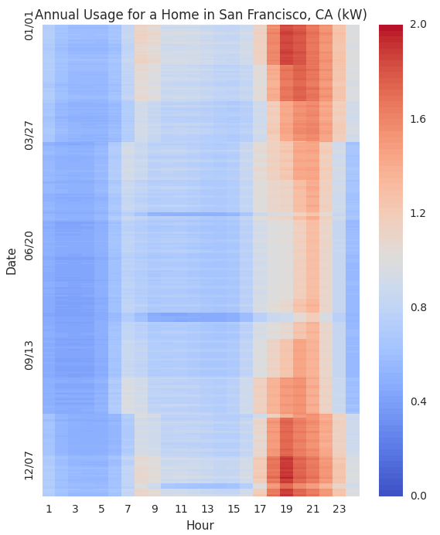
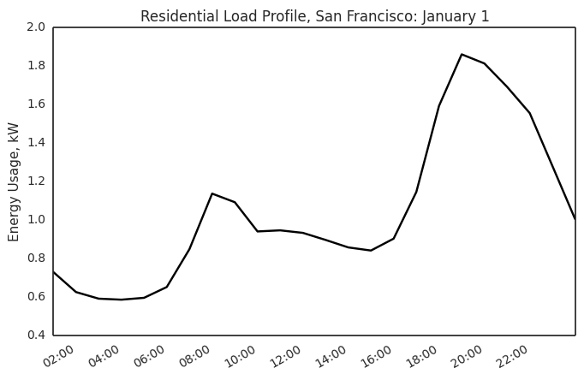
SF residential data

Slide 9
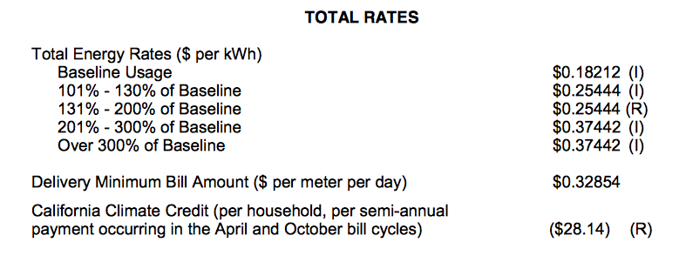
Exploring the PG&E tariffs
What does a homeowner pay for electricity?
PG&E electric schedule E-1:
http://www.pge.com/tariffs/tm2/pdf/ELEC_SCHEDS_E-1.pdf
Notes:
-average price in the region ~25center/kWh

Slide 10
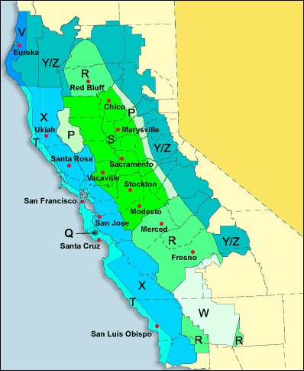
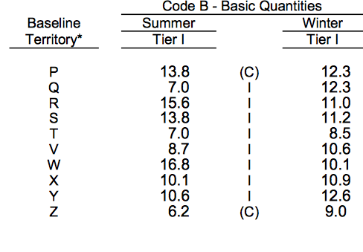
San Francisco baseline
Zip code look-up
7kWh summer, 8kWh winter
http://www.pge.com/tariffs/tm2/pdf/ELEC_SCHEDS_E-1.pdf
http://www.pge.com/en/myhome/saveenergymoney/financialassistance/medicalbaseline/understand/index.page?WT.mc_id=Vanity_baseline
Notes:
-different regions have different baselines
Summer: May-Oct
Winter: November-April

Slide 11
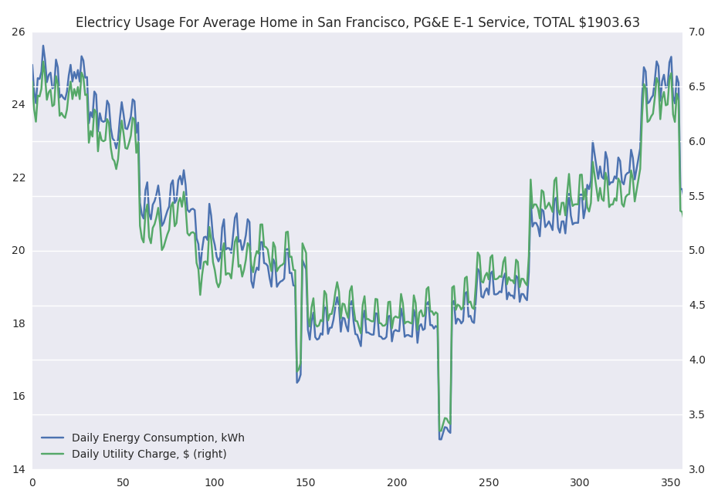
Aligning cost and usage
Notes:
Simulating a years worth of electricty costs based on usage data
-calcualte the usage each day - %of the baseline and allocate a cost to that

Slide 12
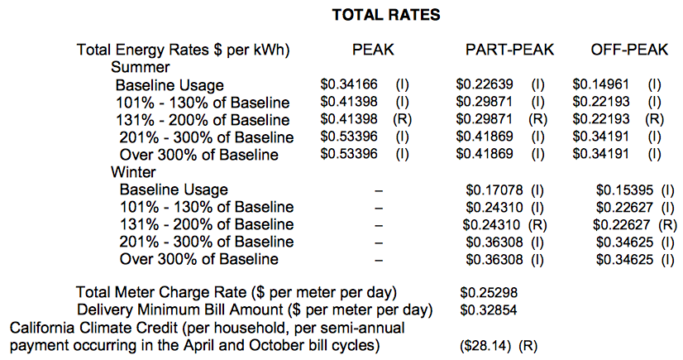
TOU: Utility tariff for a clean-energy grid
Time-of-use tariff incentivizing usage during off-peak
PG&E E-6 schedule
http://www.pge.com/tariffs/tm2/pdf/ELEC_SCHEDS_E-6.pdf
Notes:
Efforts by PG&E to promote a time-of-use rate tariff which charges users different amounts during times of day
-begins to break up the tiered rate structure, add more flexibility to usage patterns

Slide 13
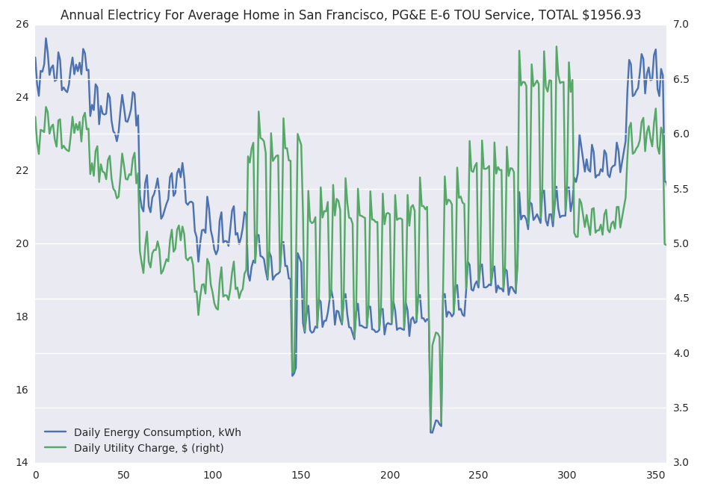
TOU (no battery)
Notes:
-again aligned cost and usage
Total cost $1956
-more than the E-1 tiered rate, makes sense, incentivized to swtich consumption on the new rate plan so you’re slightly penalized if you don’t
-% each day of baseline, also need to track what times usage occurred? Peak/partial-peak/off-peak? – what percentage of the total? Then assign a cost to each day

Slide 14
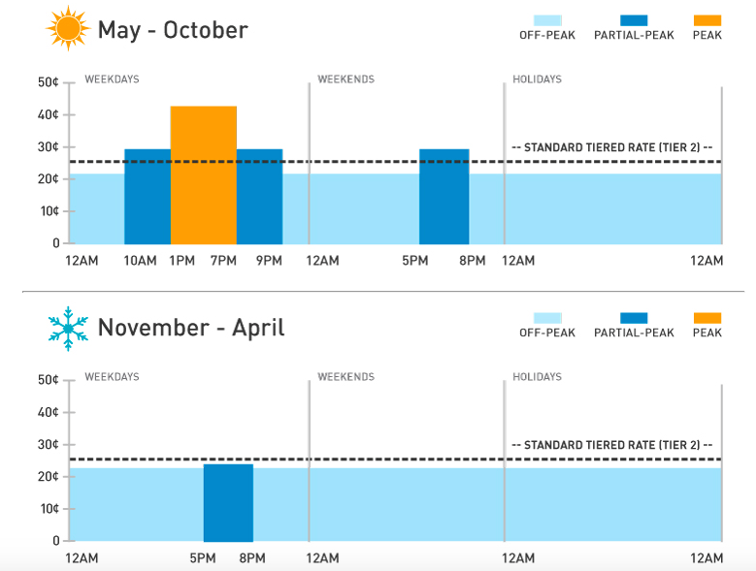
Building a simple battery dispatch algorithm
charge
discharge
http://www.pge.com/en/myhome/saveenergymoney/plans/tou/index.page
Notes:
-nice graphic from PG&E to show the TOU rate charges
-overlayed these rectanges to show how I started to think about a battery dispatch strategy
-charge during off-peak times 1am-5am as needed until battery is full at max charging rate (1C)
-discharge –if available during the times shown as needed
-we will be able to charge – controlled
-but can we dispatch to meet the load?

Slide 15
Powerwall assumptions
6.4kWh model (daily cycling)
5000 cycle life (~13 years)
End-of-life at 80% initial capacity (5.12kWh)
Linear capacity degradation
100% max depth-of-discharge, state of charge
3kW max power in/out, no fade
92% round-trip efficiency
Operated within recommended temp. (-20°C – 50°C)
No self-discharge, continuous operation
Static dispatch model

Slide 16
Powerwall specifications match our SF load profile
Energy
6.4kWh model (daily cycling)
Max peak-time / partial-peak load: 5.9kWh
92% round-trip efficiency ~ 6.4kWh needed
Power
3kW continuous (3kW peak)
Max energy requirement is 1.98kWh
Assumed constant power over 1hr
realistic assumption?
Notes:
Max load being offset was 5.9kWh
-tracked this in the TOU model with no battery to find the max for the entire year’s
Energy capacity fits with this requirement
Power requirement fits only if we assume a constant power requirement
-the load data is in hourly bins -- major limitation here
-we could see spikes greater than 3kW if we had higher resolution in the data
-for the sake of this project though I assumed it was constant at the hourly-rate

Slide 17
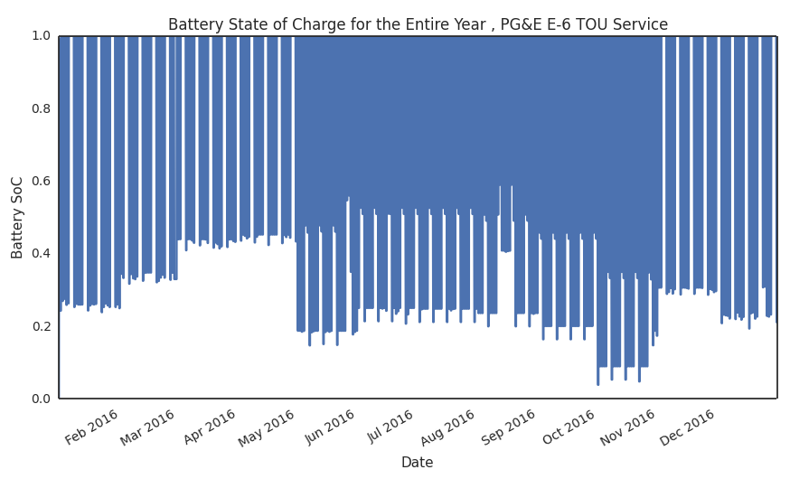
SOC
Notes:
Building the battery into the TOU model from before
-tracked battery SOC, charged it during the morning hours and discharge during the times mentioned before to offset cost (if capacity is available in the battery)

Slide 18
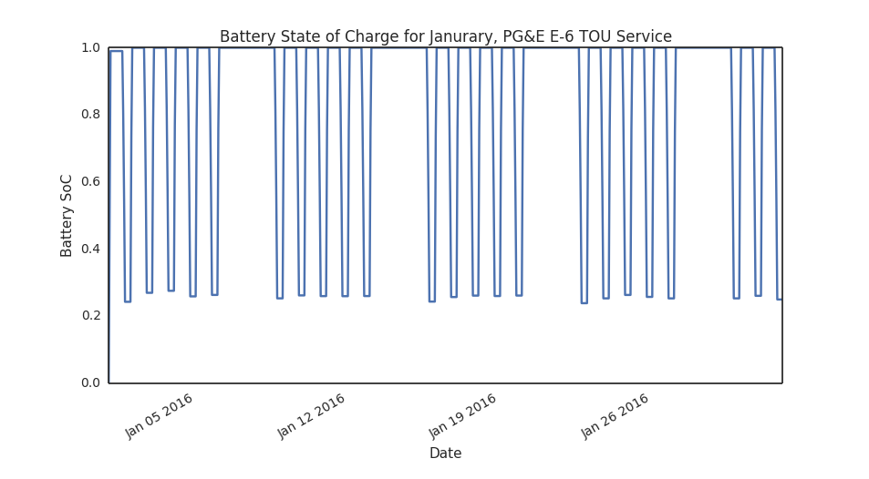
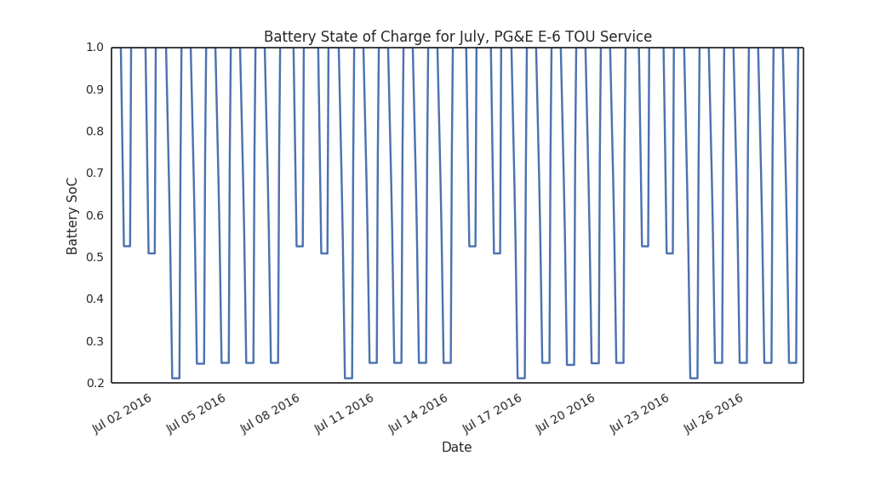
SOC sample
Notes:
-January(winter) – 5 day cycling (Monday-Friday) for partial peak pricing from 5pm-8pm in the eveing
-July (summer) – 7 day cycling (Sunday-sunday) for peak pricing from 1-7pm M-F, and 5pm-8pm on the weekends
Intuitive sense, less usage on weekends although we’re still draining same time period as winter, the SOC is higher in the summer

Slide 19
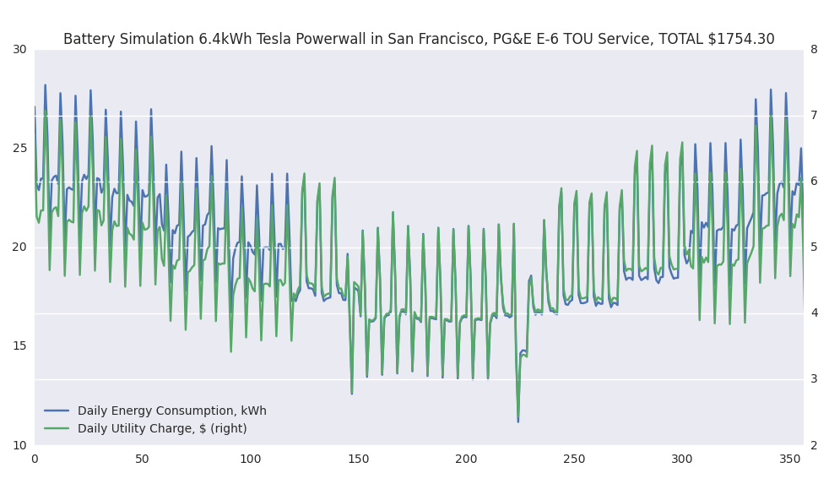
TOU (with battery)
Notes:
More spikes and dips in usage, total energy actually higher than before due to the 92% battery efficiency
-dips = when we use battery energy, lower charge from grid,

Slide 20
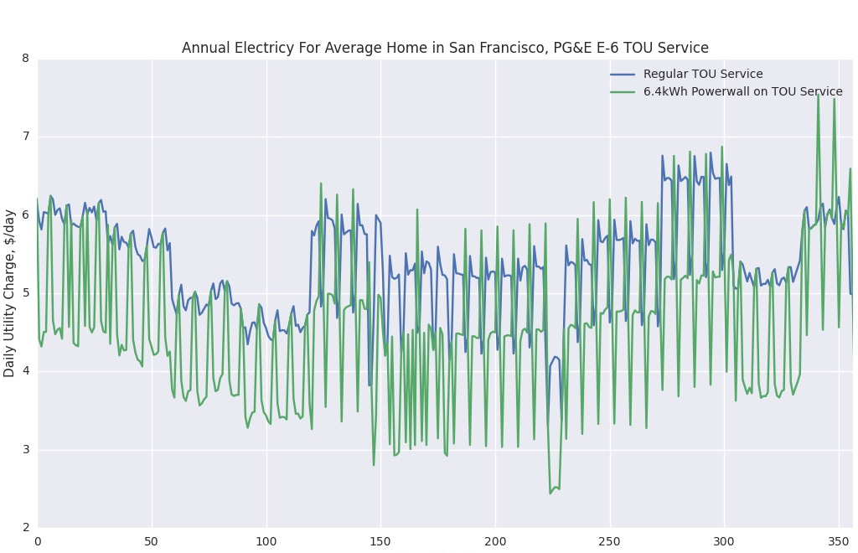
Battery reduces cost ~$1 - $1.50/day
Notes:
Comparing the cost from before, the battery reduces dailiy charge (when it’s used) by about 1-1.50 per day
-good way to think about it
-save about $300 per year?

Slide 21
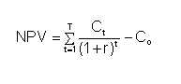
Net Present Value Analysis
Initial investment (C_{o}): $5500
Battery: $3000
Inverter/BOS: $1500
Install costs: $1000
Cash flows are electricity cost savings
Annual cost on E-1 – E-6 w. battery
10% project discount rate
2% utility price escalation rate
Project life is battery life (5000 cycles ~ 13 years)
No incentives/rebates
No taxes, no depreciation/salvage value, no O&M cost
Notes:
Financial assumptions
-can’’t just look at 1 year, need to see for the entire year of the battery
-compare the standard E-1 schedule with the E-6 rate + battery

Slide 22
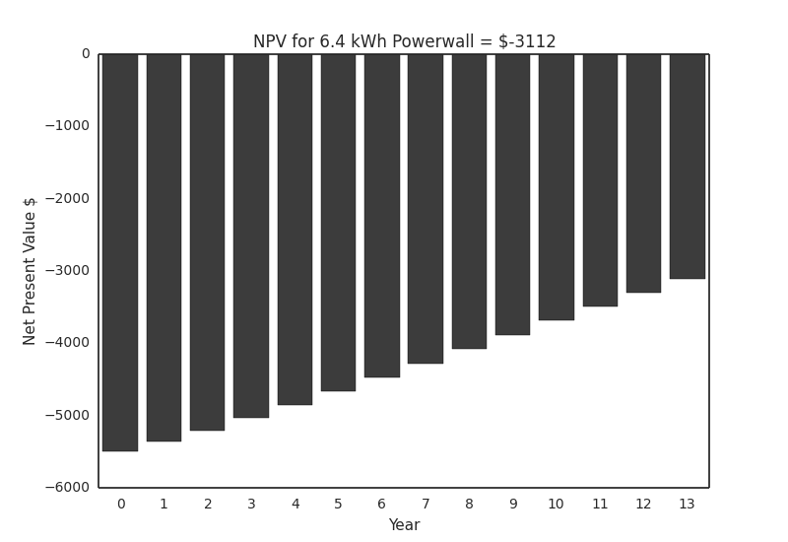
No positive payback for Powerwall in SF
Notes:
REUSLT, given standard assumptions, battery in SF region of CA does NOT make financial sense for residential customers
--
No PV included
-if we consider the case of a homeowner with PV – they can use the battery to USE more PV energy
-BUT still, the current tariff structure as NEM – so excess energy is backfed onto the grid at retail rate
-doesn’t make sense to want to use the battery because you lose energy through eff. loss!

Slide 23
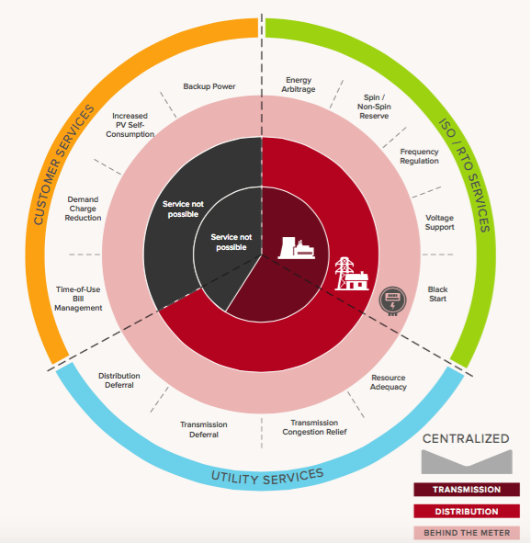
Battery storage needs financial help
Negative NPV can be offset by:
Incentives / rebates (SGIP program from PG&E)
Unsustainable
Alternative revenue streams
Pay for behind-the-meter services
Where the grid is headed
http://www.rmi.org/electricity_battery_value
Notes:
RMI paper
-battery storage when behind-the-meter can be aggregated to provide ALL GRID SERVICES
-the further downstream the better for the grid!

Slide 24
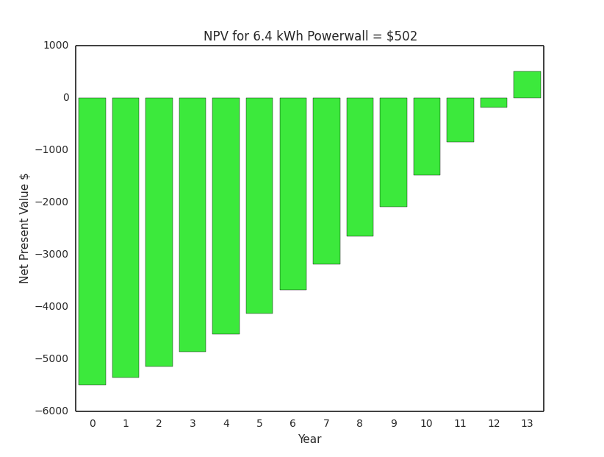
5% utility price escalation, 7% discount rate
Notes:
Without looking into these alternative revenue streams
-I made assumptions that could be tweaked
----limitation is I approached the case from the NPV side , better might be the internal rate of return (IRR)
-instead of assuming a discount rate, we solve for the discount rate that yields a positive NPV
-can compare that to alternative projects (higher the IRR the better!)
-bond~1-2% depending on the length
Either way, play around with parameters to see what will yield a positive NPV
-played with many different scenarios, for exmaple. High cabron tax, utility price escalation goes way up

Slide 25
What about other regions?
Different PG&E ‘territories’
Different baselines
Different load profiles
Create a tool to vary the region / parameters
Use Tkinter library in python to create a simple application
Another way to ‘play-around’ with NPV
DEMO
Notes:
Utilize more of the dataset?
-how to incorporate the utility tariffs?
-stick with PG&E but alter the baselines

Slide 26
Key learning takeaways
Visualizing the data
Can use open datasets (OpenEI, green button, etc.)
Finding the best way / tools to visualize energy data
Understanding the tariffs
Different across the county
How to build that into a model
Understanding battery limitations
Modeling battery performance / yielding a favorable payback
Importance of battery storage for grid modernization
Currently rely on incentives / revenue streams not yet available
Resi v. commercial v. utility scale

Slide 27
Questions?

Slide 28
Backup: Information about dataset
http://en.openei.org/datasets/dataset/commercial-and-residential-hourly-load-profiles-for-all-tmy3-locations-in-the-united-states information
About 1000 csv files
20GB
Hourly load

